Slide 1
Cost Curves
05/02/2018
C. Drummond and R. C. Holte, “Cost curves: An improved method for visualizing classifier performance,” Mach Learn, vol. 65, pp. 95–130, 2006.

Slide 2
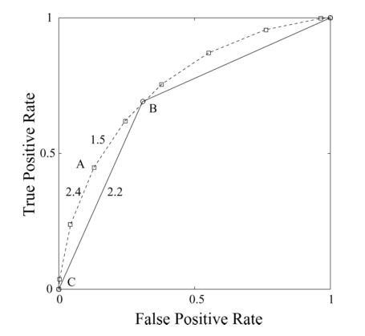
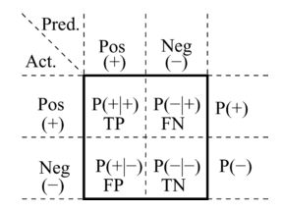
ROC Curves
Notes:
Author arguing that cost curves are better than ROC curves for analysing classifiers
Quick ROC curve review
Binary classifier creates a confusion matrix - true positive rate and false positive rate
Plot tpr and fpr as a single point
Varying threshold creates many confusion matrices - creates an roc curve
Being above and to the left is better
“discrimination power independent of any ‘acceptable criterion’ employed”

Slide 3
what is classifier C’s performance (expected cost) given specific misclassification costs and class probabilities?
for what misclassification costs and class probabilities does classifier C outperform the trivial classifiers that assign all examples to the same class?
for what misclassification costs and class probabilities does classifier C1 outperform classifier C2?
what is the difference in performance between classifier C1 and classifier C2?
what is the average of performance results from several independent evaluations of classifier C (e.g. from 10-fold cross-validation)?
what is the 90% confidence interval for classifier C’s performance?
for what misclassification costs and class probabilities is the difference in performance between classifier C1 and classifier C2 statistically significant?

Slide 4
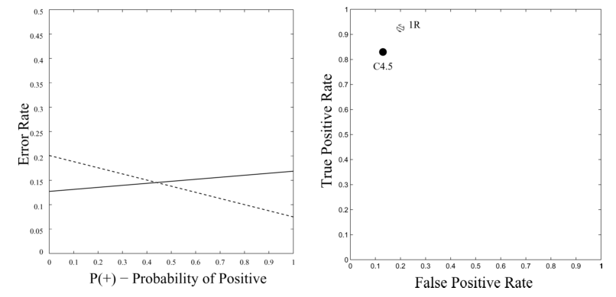
Cost Curves
Y = error rate = (FN −FP) ∗ p(+) + FP
FP = b, TP = 1 − (b + a)
Notes:
Designed for specific performance measure - expected cost
Assume misclassification costs are equal for now
Plot error rate against class ratio
p(+) train vs test vs deploy - don’t assume we know deploy so test classifier on full range of class ratios
p(+) = 0, er = fpr
p(+) = 1, er = 1 - tpr
Line in cost space = point in roc space

Slide 5
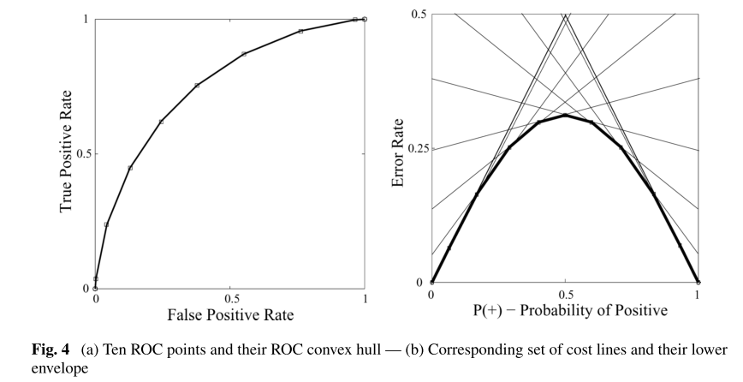
Cost Curves
Notes:
Convex hull of an roc curve compared to the equivalent lower envelope of a cost curve
Thresholds are varied and tpr/fpr for each thresh is plotted
Creates a series of cost lines which combine to form a lower envelope

Slide 6
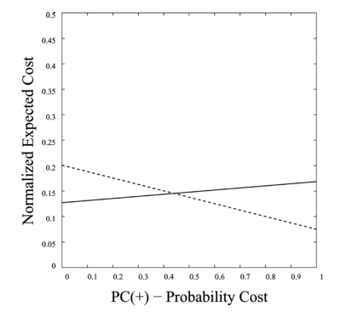
Cost Curves
PC(a) = p(a) ∗ C(a|a) / (p(+) ∗ C(−|+) + p(−) ∗ C(+|−))
Norm(E[Cost]) = (FN −FP) ∗ PC(+) + FP
Notes:
Bunch of math - assign misclassification cost to each class
Redefine axis - PC is probability x cost - simplifies to p(+) when costs are equal
Normalized expected cost - simplifies to FP when PC(+)=0 and FN when PC(+)=1

Slide 7
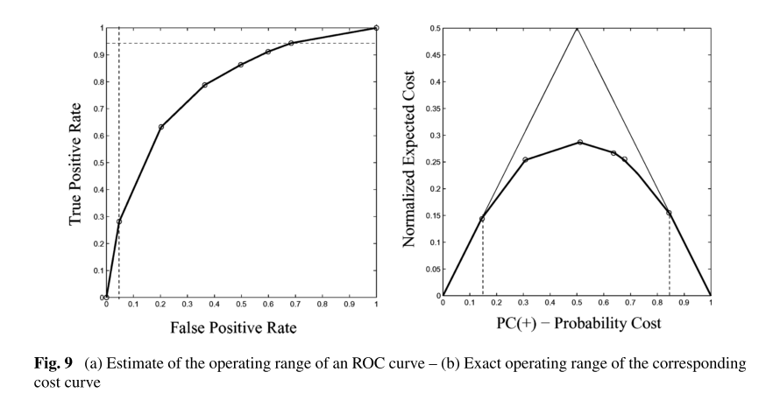
Comparing a classifier to the trivial classifiers
Notes:
In an ROC curve the operating range of a classifier is defined by the slopes of the lines connecting the classifier’s ROC point to (0,0) and (1,1)
Slopes are difficult to judge visually. Can be approximated from the min FP and max TP values
Easy to see on a cost curve, as one sees where the lower envelope goes above the trivial classifier lines

Slide 8
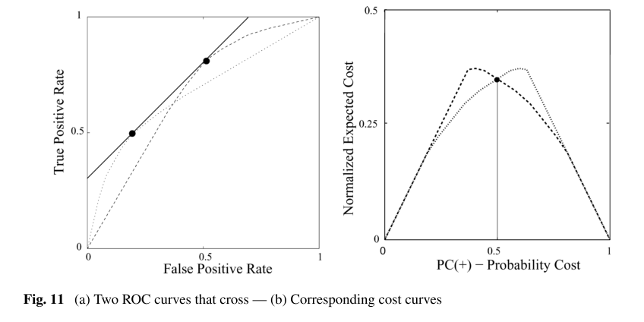
Choosing between classifiers
Notes:
Point at which two classifiers are equal is difficult to judge in roc
Slope of tangent line connecting two roc curves represents operating point where they are equal
Can clearly see in cost curve under which operating conditions one classifier outperforms another

Slide 9
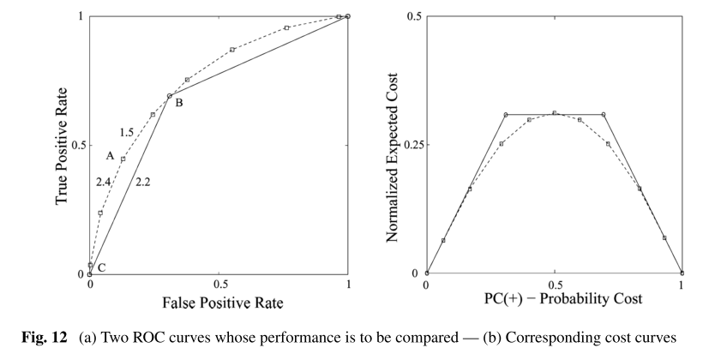
Comparing classifier performance
Notes:
Dotted curve better than line, but by how much, and at what operating point?
In cost curve its easy to see at what operating point they are equal, and measure the difference in expected cost

Slide 10
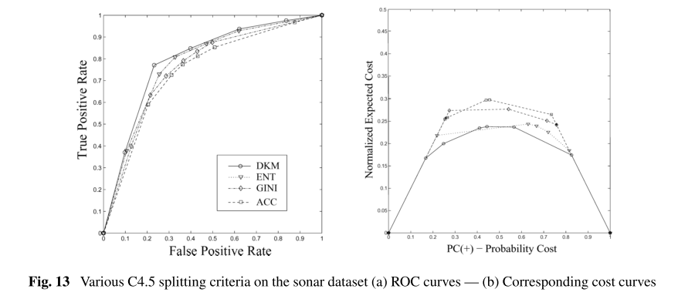
Comparing classifier performance
Notes:
Similar example on real classifier data
Jumbled and confusing in roc space, more clear in cost space

Slide 11
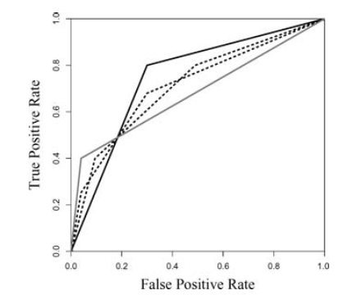
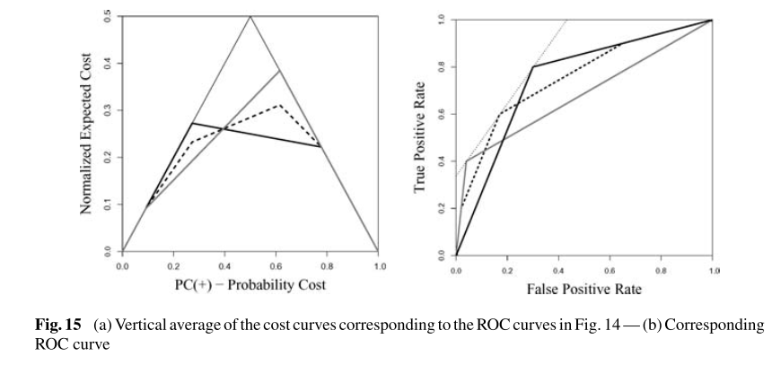
Averaging cost curves
Notes:
Figure on right shows two methods of averaging a set of roc curves, vertical and horizontal averaging - results differ
An important shortcoming of these methods of averaging is that the performance (error rate, or cost) of the average curve is not the average performance of the two given curves
Figure on left averages those curves in cost space and shows the transformation back to roc space

Slide 12
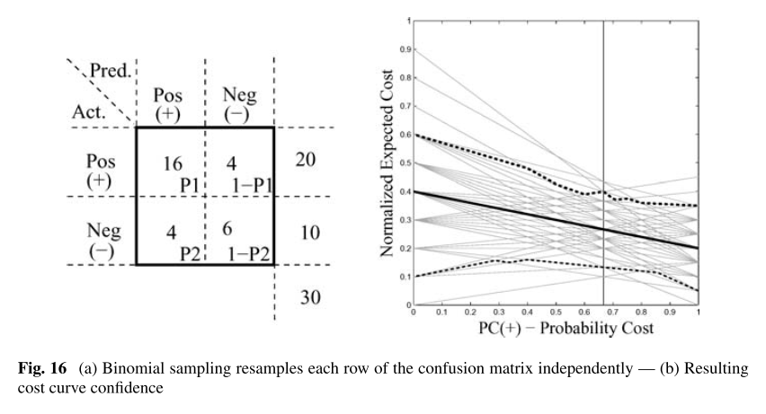
Confidence intervals on cost lines
Notes:
Resamples the confusion matrix multiple times to get an estimate of the confidence intervals

