Slide 1
Marginal shape deep learning: applications to pediatric lung field segmentation
A Mansoora, J Cerrolazaa, G Perezb, E Biggsa, G Ninob,
M Lingurarua,c
Childrens National Medical Center, Childrens National Health System, George Washington University, Washington DC
Presented by: Michael Hardisty
@ Journal Club November 27, 2017

Slide 2
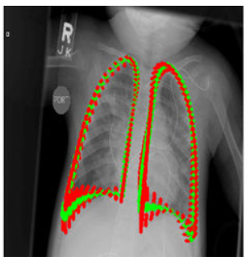
Problem
Segmentation of lung from chest radiographs
combine a statistical shape model with automatic feature detection of deep learning

Slide 3
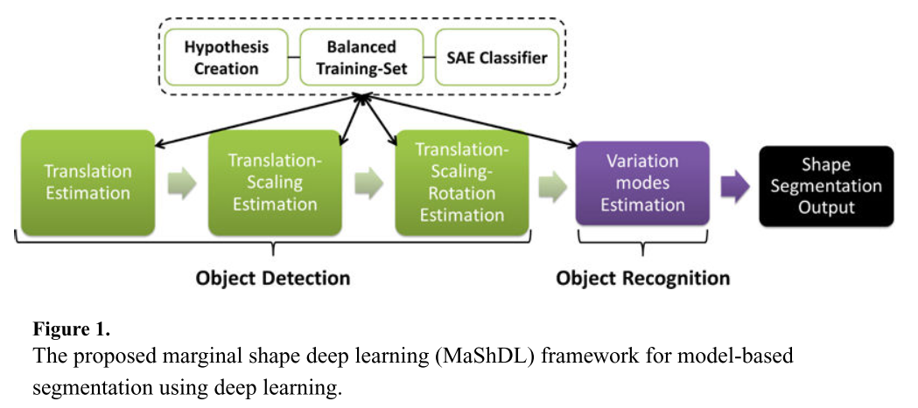
Method

Slide 4
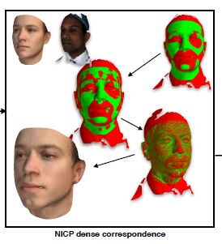
Statistical Shape Model
Register all training cases together (rigid, deformable)
Y - case
M – mean shape
V_{k} – Eigen vectors
C_{k} – Eigen values
Booth 2016
Notes:
Dense correspondence
register all cases
Rigid
Deformable
Mapping back to org
Correspondence can be acquired by choosing landmarks that are on all of the cases
Basis determination by eigen analysis

Slide 5
Object Detection and Recognition
Ω - Shape parameter vector
T – translation
R – rotation
S – scaling
c – eigen values
Notes:
This makes segmentation within really look a lot like detection problem ie translation rotation scaling
they then train a classifier to identify correct parameter vectors from incorrect parameter vectors
point out that an exhaustive search of parameters in omega is impractical an instead they will break it up the parameter space into marginal subspaces
- break this up into more restricted subdomains

Slide 6
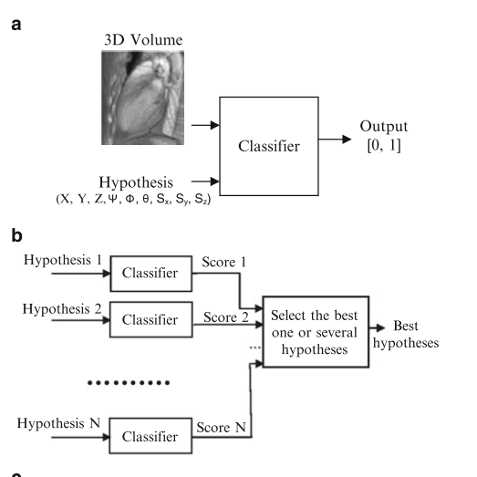
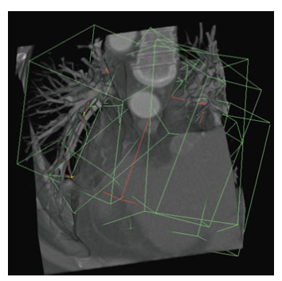
Classifier Architecture
Zheng 2014

Slide 7
Marginal Learning
Notes:
n9. For a very coarse estimation with n = 10, n9 =1,000,000,000 for 3D instead of n5 =100,000
incrementally learning in lower dimensional spaces

Slide 8
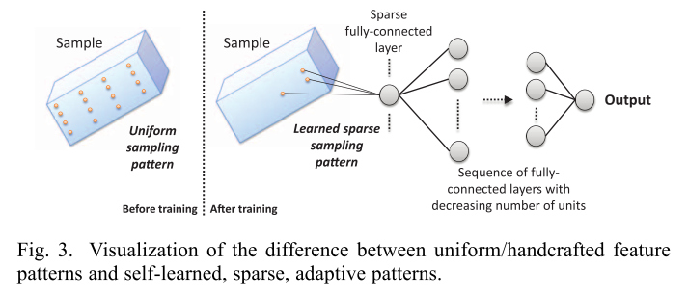
Sparse Deep Network
Ghesu 2016

Slide 9
Experiment
segmenting lung
314 patients images
0.1mm pixel size
50 – 50 split training and testing
batch size 100
100 epochs

Slide 10
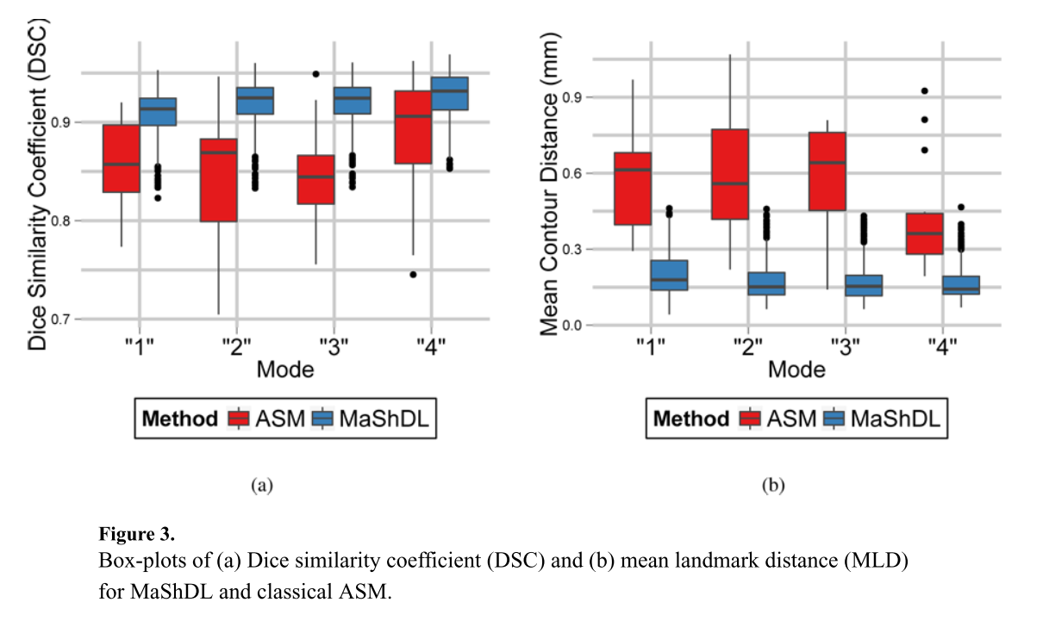
Results

Slide 11
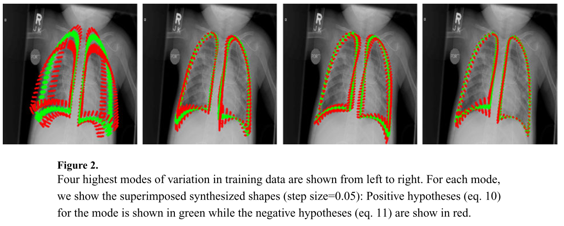
Results

