Slide 1
Monday, October 30th 2017
Notes:
Last several journal club sessions have been on segmentation (my own project)
Want to talk about something a little different
Posted on biorxiv in august, presented at ASNR 2017

Slide 2
Objective
Wanted to compare the performance of various different NLP techniques for text mining radiology reports
Purpose of mining reports is to provide clinical support services
Comparison of non-neural and neural network models (SVM, CNN and NAM)
Notes:
Neural attention model (CNN + prediction heat map)

Slide 3
Data
Non-contrast head CTs for altered mental status in ICUs
1400 reports annotated independently by 3 radiologists
5 classifications given to each report, each with a scale of 0 to 2
Study severity
Acute intracranial bleed
Mass effect
Acute stroke
Hydrocephalus
80,000 unannotated continuous CT head reports
Notes:
1000/200/200 training/testing/validation split
0 -> normal
1 -> abnormal but not acute and communicable
2 -> abnormal and acute and communicable
Classes were binarized before being fed into the ML algorithms
Scores <2 grouped as negative, scores of 2 grouped as positive

Slide 4
Preprocessing
SVM based method used a bag-of-words (BOW) word representation to feature engineer the classifier.
Neural network methods used Word2vec representation, trained on the 80,000 unannotated reports
Notes:
Arguably the most important part of the NLP machine learning process, choosing a word representation scheme
Many existing ways to represent words for computers to understand
Bag of words - text is converted into frequencies of word occurrences. Does not preserve word order or context

Slide 5
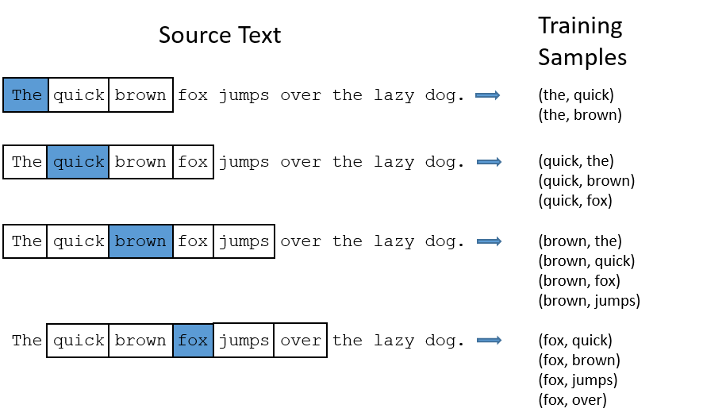
Word2vec
Notes:
Developed by researchers at Google, open source group of models, become somewhat standard in this field
Encoder/decoder model, try to learn likelihood of words appearing together
Takes a large corpus of text and outputs a vector space, with each unique word being assigned a vector in the space
Words that share similar contexts are close together in the vector space
Training samples are extracted. This example only has context window of 2 - typically use 5

Slide 6
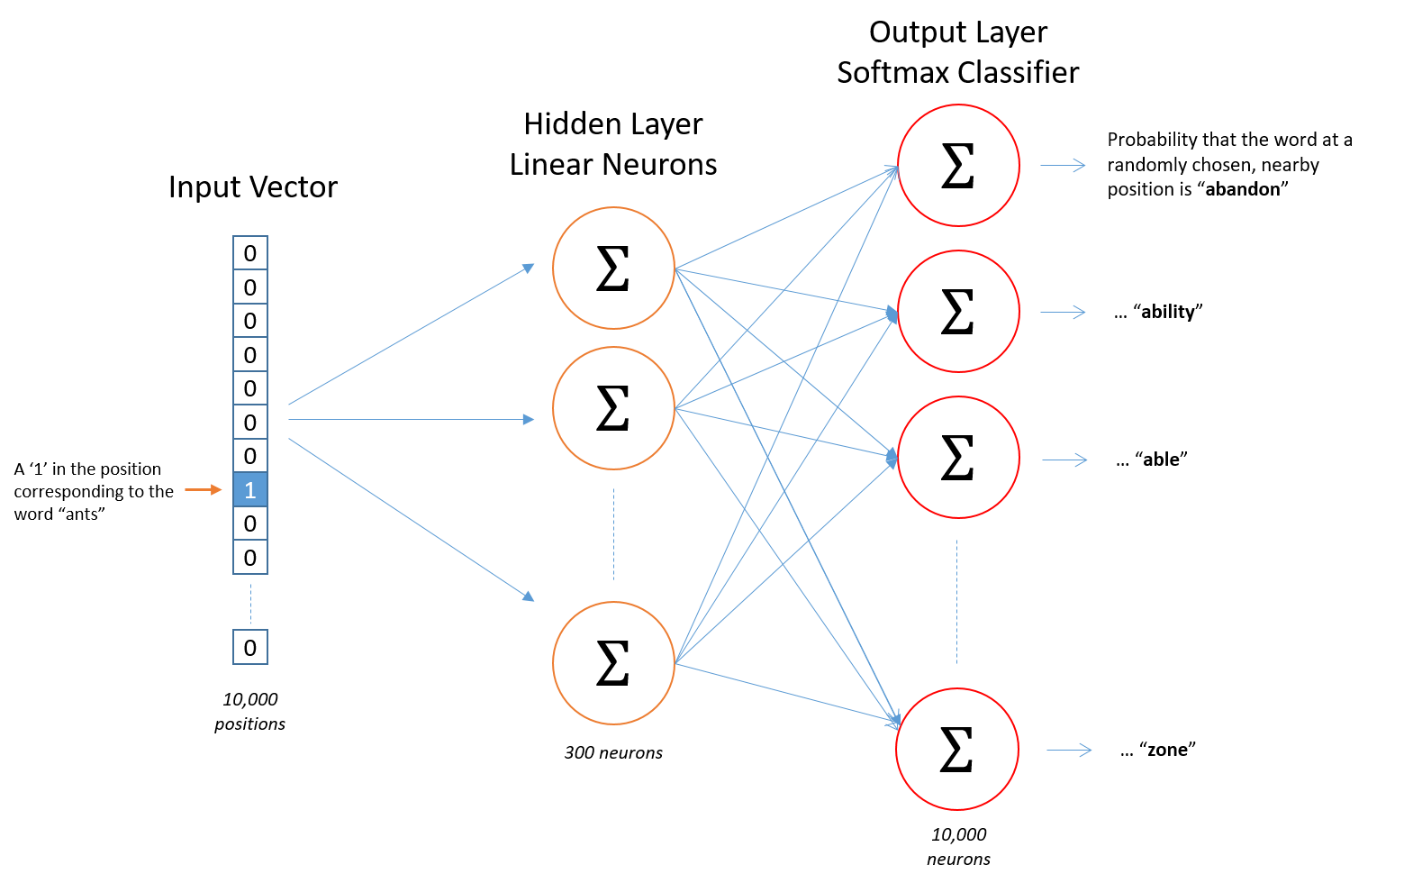
Word2vec
Notes:
One hot input vector, length of number of unique words in vocabulary
Output probability of each word appearing near input word.
Learn a hidden layer of neurons which correspond to the vector space representation of your corpus
Number of neurons is number of dimensions in vector space - between 100 and 1000.
Rows in weight matrix are vectors in the space
More neurons are more accurate, but there is a diminishing return at higher numbers.
Allows algebraic operations of words: “Brother” - ”Man” + ”Woman” close to “Sister”

Slide 7
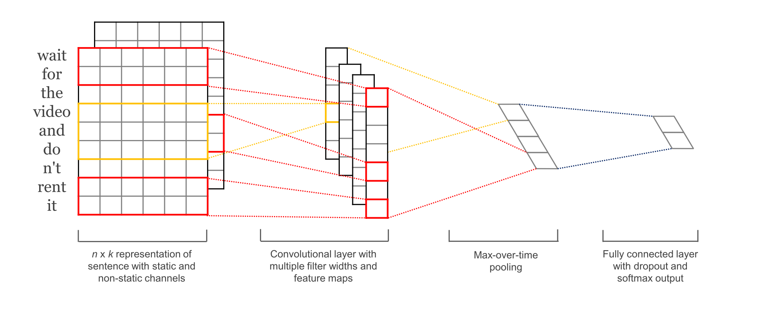
CNN
Kim, Y. (2014). Convolutional Neural Networks for Sentence Classification
Notes:
CNNs a bit different in NLP
Wait for the video and don’t rent it - n=6 vector representation of words
Convolve over full width of matrix - want all components of vectors
Alter region size - typical to use larger region sizes
Many more hyperparameters - padding, strides, pooling, activations, # of filters

Slide 8
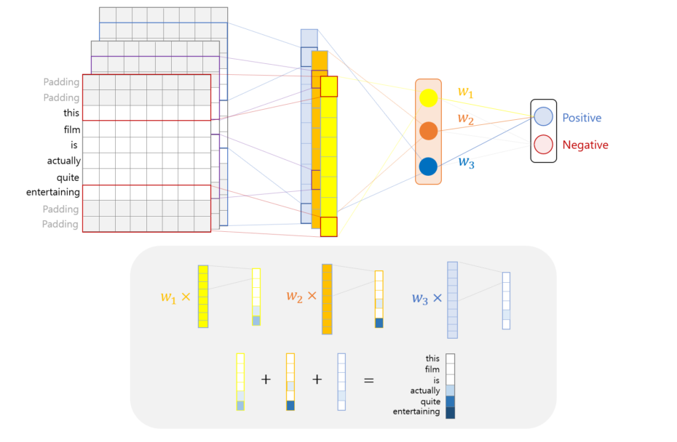
NAM
G. Lee, J. Jeong, S. Seo, C. Kim, and P. Kang, “Sentiment Classification with Word Attention based on Weakly Supervised Learning with a Convolutional Neural Network.”
Notes:
Attention models in NLP traditionally used in machine translation
Encoder decoder networks - encode sentence into a hidden state, then decode into the target language
Attention model adds a hidden state for each word, and is able to trace contributions for each output word to the hidden states
In CNN model, final vector is used as the weights to go back and multiply the feature vectors
Produces an attention vector with a value corresponding to each word in the document

Slide 9
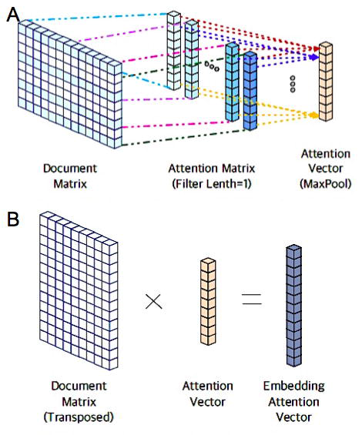
Notes:
Diagrammatic representations of the models in the paper
A is the CNN
B is the NAM

Slide 10
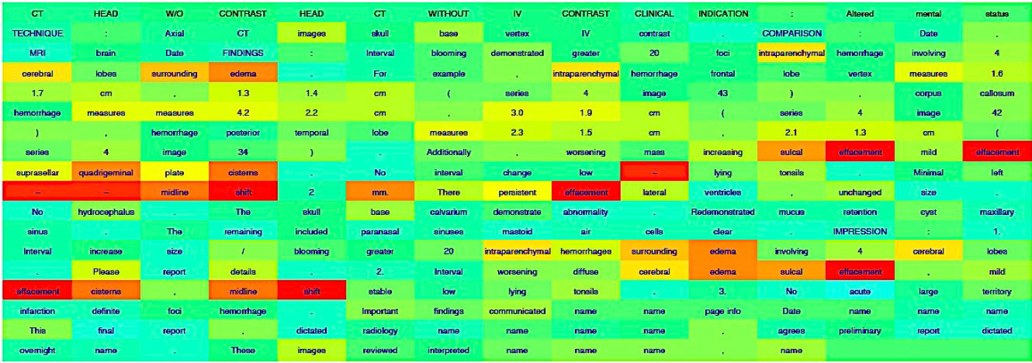
NAM heat map
Notes:
Example report classified by the NAM model. Report classified positive for mass effect
Red words are those used to inform the classification

Slide 11
Results
Notes:
Table showing the distribution of the dataset
Categories were binarized
Quite a bit of class imbalance, paper didn’t really talk about how they dealt with that

Slide 12
Results
Notes:
Also included many roc plots. AUC for all method for all classes was above 0.92
Talk about how previous methods rely on published medical language ontologies
Word2vec representation allows new word associations to be learned
Cited limitations of the study are similar to what many machine learning biomed papers suffer from
Small sample of annotated report as the annotations are hard to get
Population from a single institution.

