Slide 1
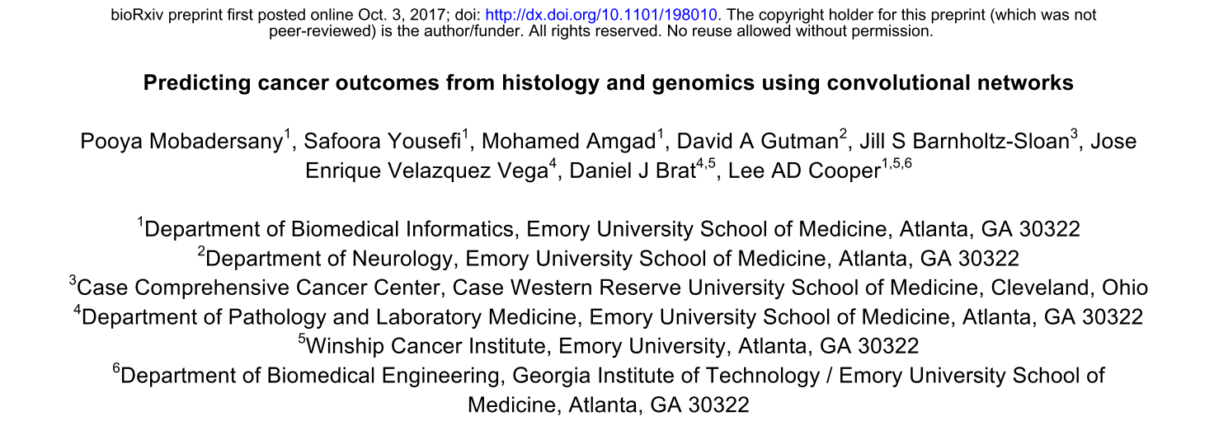

Slide 2
Paper is interesting because:
Learning a survival model – not common (yet!)
Analyzing large whole slide images
1 40x resolution slide could have 50,000 image patches of 256x256 pixels
Has to learn model using only patient level annotation from very heterogeneous slides
Combines genomic information with histology image information to improve risk estimate

Slide 3
Prediction of survival for glioma patients
Using data from The Cancer Genome Atlas
Lower Grade Glioma (LGG) and Glioblastoma (GBM) projects.
1061 whole-slide images from 769 unique patients
Reviewed to remove images containing tissue processing artifacts

Slide 4
Notes:
H&E FFPE sections from the Brain Lower Grade Glioma (LGG) and the Glioblastoma (GBM) cohorts were reviewed
remove images containing tissue processing artifacts including bubbles, section folds, pen markings and poor staining.
Representative regions of interest containing primarily tumor nuclei were manually identified for each slide that passed quality control.
In the case of grade IV disease, some regions include microvascular proliferation as this feature was exhibited throughout tumor regions.
Regions containing geographic necrosis were excluded.

Slide 5
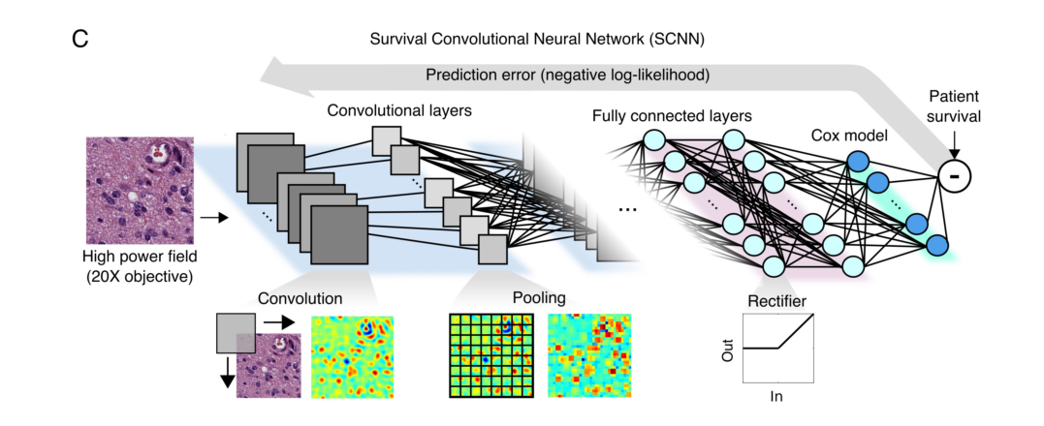

Slide 6
Cox proportional hazards model
Underlying hazard function is h₀(t)
Describes how risk of event per time unit changes over time
In practice want to model survival as a function of both time and clinical and treatment covariates
h(t|x) = h₀(t) exp( β₁x₁ + β ₂x₂ + …… + β _{p}x_{p})
assumes that relative hazards are not time dependent
assumes right censored data
Notes:
Hazard function is time dependent – death rate from a specific disease will tend to vary over time
In a proportional hazards model, the unique effect of a unit increase in a covariate is multiplicative with respect to the hazard rate. For example, taking a drug may halve one's hazard rate for a stroke occurring

Slide 7
Cox proportional hazards model
If there are n_{j} subjects alive just before time t_{j} when 1 death occurs then probability that the death was of a particular subject is
p_{j} = exp( β₁x₁) / ∑ exp( β_{i}x_{i})
Negative partial log-likelihood used for back-prop
U and Ωi were calculated for each min batch comprising 14 HPFs each
Notes:
Calculation of the Cox partial likelihood requires access to the predicted risks of all samples, which are not available within any single mini-batch, and
so Cox likelihood was calculated locally within each mini-batch to perform updates (U and Ω1 were restricted to samples within each mini-batch).
where β ∈ ℝ()* × - are the 256 terminal layer weights and X ∈ ℝ()* × - are the 256 inputs to this layer

Slide 8
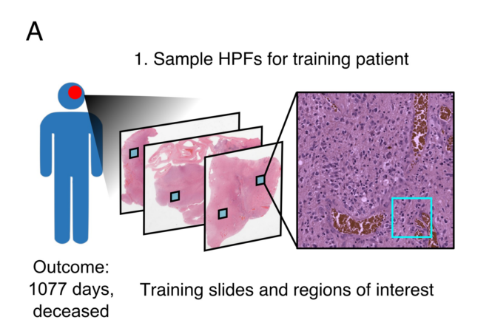

Slide 9
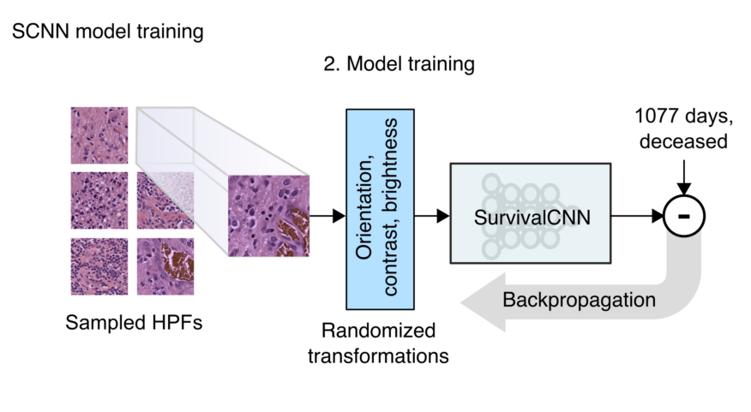
Notes:
The HPFs are resampled at the beginning of each training epoch to generate an entirely new set of HPFs. Randomized transforms were also applied to these HPFs to improve robustness to tissue orientation and color variations. Since the visual patterns in tissues can often be anisotropic, we randomly apply a mirror transform to each HPF. We also generate random transformations of contrast and brightness using the “random_contrast” and “random_brightness” TensorFlow transformations to modify the HPF and simulate color variations. These resampling and transformation procedures, along with the use of multiple HPFs for each patient, has the effect of augmenting the effective size of the labeled training data

Slide 10
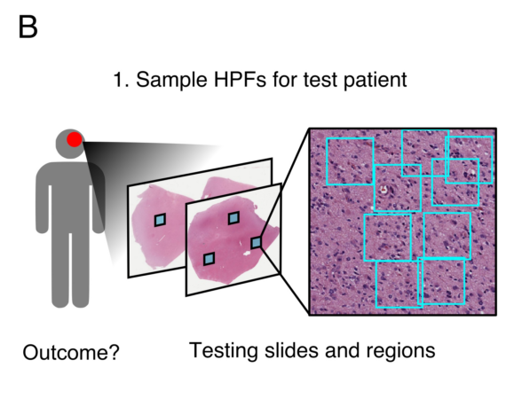
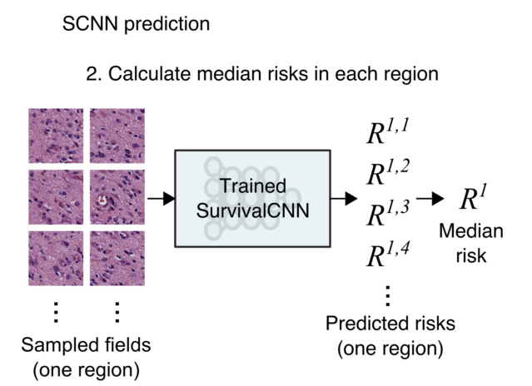
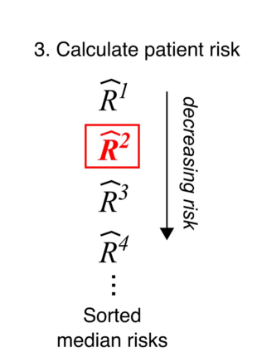
Notes:
Resampling was also performed to increase the robustness and stability of predictions: 1) 9 high-power fields are first sampled from each region j corresponding to patient E 2) The risk of the kth HPF in region j for patient m, denoted R^{j,k}_{m}
:,H, is then calculated using the trained SCNN model
3) The median risk !G : = medianH !G :,H is calculated for region j using the aforementioned HPFs to reject
outlying risks 4) These median risks are then sorted from highest to lowest !G - > !G ( > !G P … , where the
superscript index now corresponds to the risk rank 5) The risk prediction for patient E is then selected as the second highest risk !G
∗ = !G ( . This

Slide 11
Generating final risk estimate per patient in test data.
Take median risk for jth region from K HPFs
Sort median risks from J regions and take second highest
Do this using 5 models trained for epochs 96-100 and average result
Split data into 80% training, 20% testing
15 randomized splits (patient level)
C-indexes generated by Monte Carlo cross-validation compared using the Wilcoxon signed rank test.

Slide 12
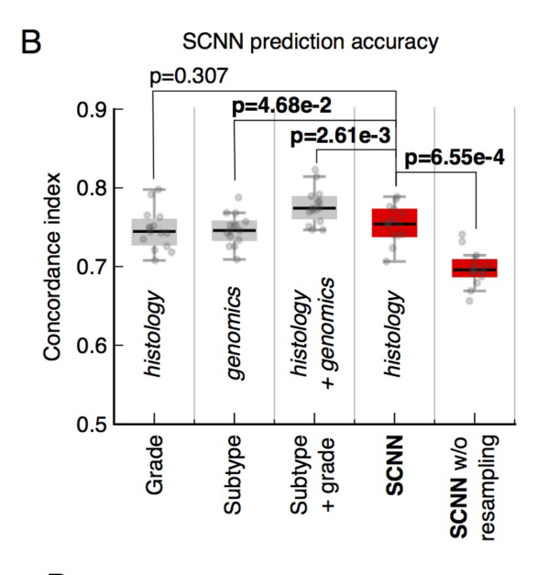
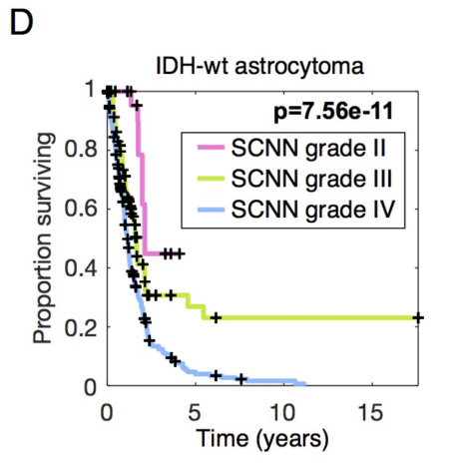
Concordance c-index
Harrell et al 1996
Rank order statistic gives probability that a randomly selected patient who experienced an event had a higher risk score than one who did not
Notes:
Hazard function is time dependent – death rate from a specific disease will tend to vary over time
In a proportional hazards model, the unique effect of a unit increase in a covariate is multiplicative with respect to the hazard rate. For example, taking a drug may halve one's hazard rate for a stroke occurring

Slide 13
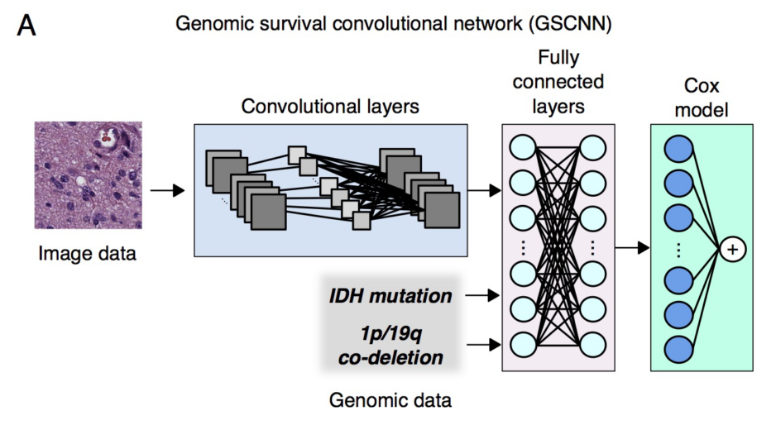

Slide 14
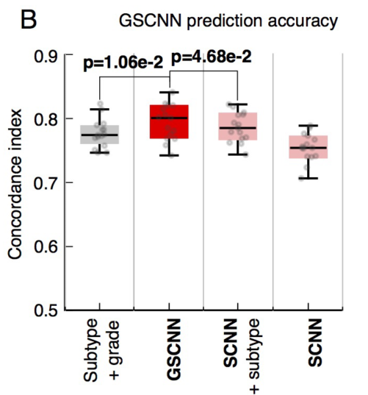

Slide 16
